Slide 1

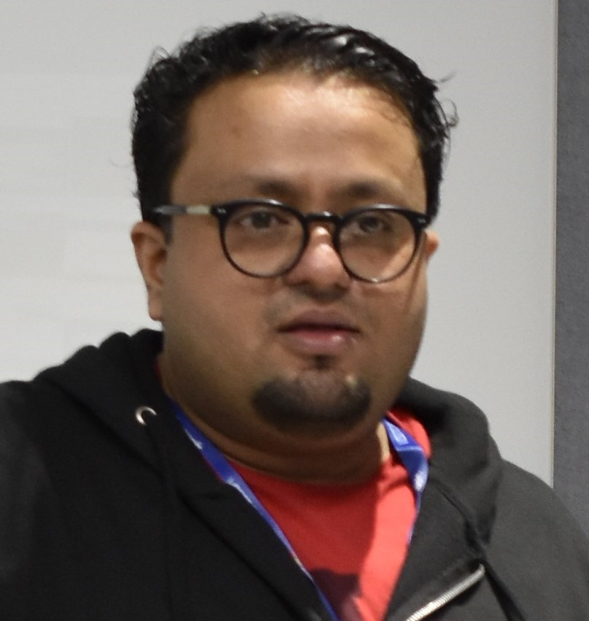
Testing the Untestable using M365 Developer Proxy
Arjun Menon
Microsoft MVP, Solution Architect

Slide 2


Massive Thanks to Our Supporters!
Organized by
Pune Tech
Community

Slide 3

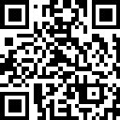

Arjun Menon
Microsoft MVP
Co-maintainer – CLI for Microsoft 365, Core Member – PnP Team
Co-maintainer of CLI for Microsoft 365
Core member of Microsoft 365 and Power Platform Community (PnP) team
Solution Architect
Grazing in the vast lands of Microsoft 365 ecosystem
/in/arjunumenon
arjunumenon
arjunumenon.com

Slide 4
Why test the untestable 🧪
Why building resilient apps is hard 🤯
How Dev Proxy makes life easier 🧘
Learn how to get started 🧑‍🏫
Audience: Developer, Tester, Administrator 🧑‍💻

Slide 5
Why we need to test the untestable
Make apps resilient
Cloud APIs Fail
Testing APIs are hard

Slide 6
Apps which are resilient
Resilience assumes that adverse conditions will occur 🌩️
Resilience is not a tick box ✅
Availability and reliability by themselves are insufficient

Slide 7
Cloud APIs fail ❌
It’s not a matter of if, it’s when
How do you know what is going to happen?
How will your app recover? Will it recover?
How do you test for failures?

Slide 8
Testing Cloud APIs are hard 😥
You don’t own the APIs
You can’t turn just turn behaviours on and off 🔘
Hard to get started
Nobody pays for testing 💵
Each API is different
Some return 429s, others 403s, some return several 429s

Slide 9

Dev Proxy to the rescue
Helps you build resilient apps on Microsoft 365
Improve robustness, performance and security
Test the untestable
Run against any app
Any platform and any tech stack
Supports any HTTP API
Presets for Microsoft Graph and SharePoint Online
Low investment (effort and time)
No code changes, no tedious setup
aka.ms/devproxy

Slide 10
Devproxy – How it helps us
Improve robustness 💪
Random errors
What happens when APIs fail?
Latency
What happens when APIs are slow?
Throttling and Rate Limiting
What happens when APIs throttle?
Improve security 🔐
Detect minimum required permissions
Are you using the right scopes?
Detect over consented applications
Is your app obtaining more permissions than it needs?

Slide 11
Let us break and make 🧨 ➡️ 🏘️
See it in action!!

Slide 12
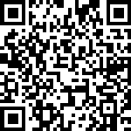
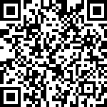
References
Item | QR | Link
Demo Artefacts |  | https://a-um.me/pune2024-repo
References / Links |  | https://a-um.me/pune2024-reference

Slide 13
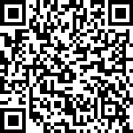
Feedback ❤️
https://a-um.me/pune2024-feedback

